Slide 1
Research Data & the Stanford Digital Repository
Amy Hodge
PhD, Yale, Molecular Biophysics & Biochemistry
Science Data Librarian
amyhodge@stanford.edu
Notes:
I'm going to talk with you for a few minutes today about Stanford Digital Repository.

Slide 2
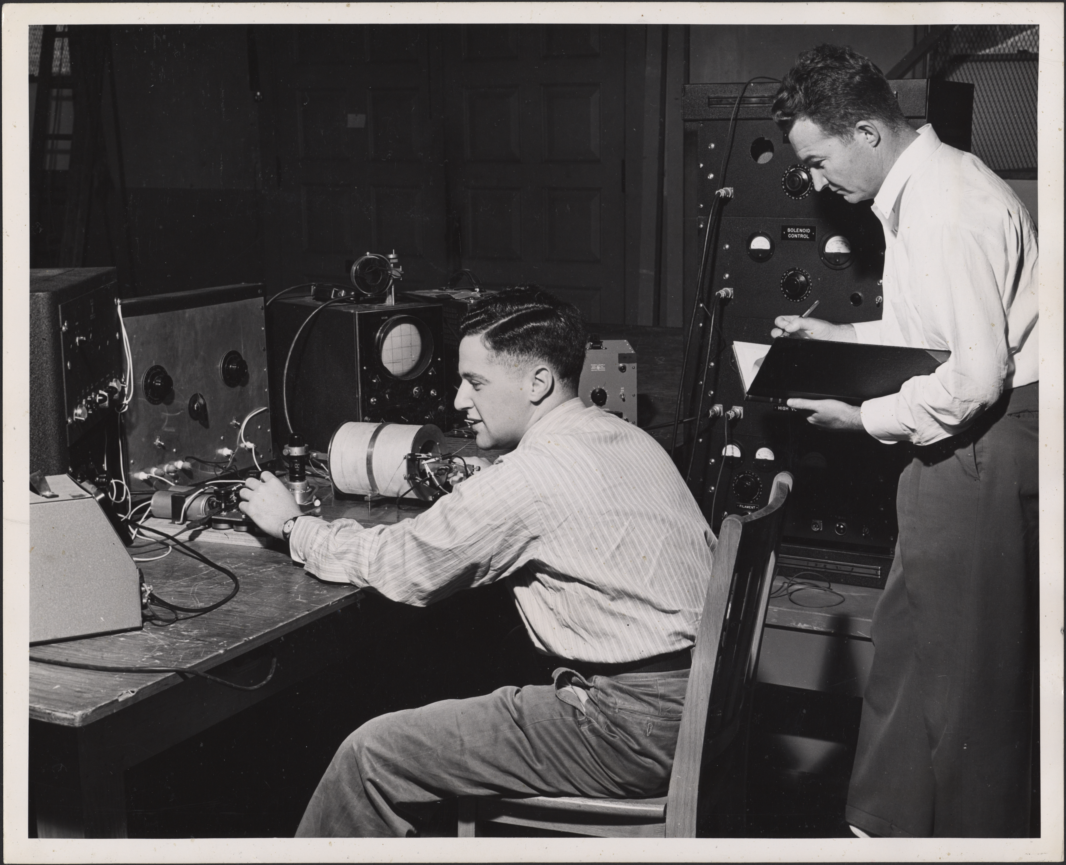
Notes:
I'll begin by telling you a few quick stories -- true stories -- about some Stanford scientists and their data.

Slide 3
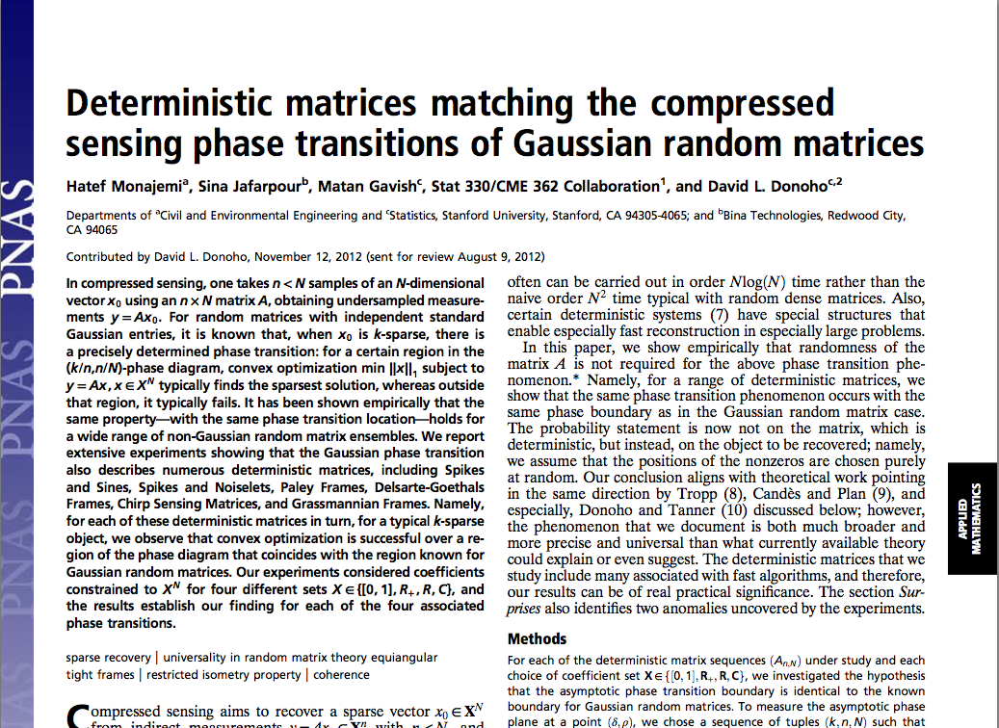
Notes:
The first story is about David Donoho, a professor of Statistics, and his graduate students Hatef and Matan. They were publishing a paper in PNAS, and the journal was requiring that they also make available online supplementary data that supported the results in the paper. David and Hatef and Matan were happy to provide these data files and even the code that had been written for this project, however, the journal did not provide any way to do this. And so Hatef went looking for a solution for publishing their supplementary data and discovered that....the SDR can do that.

Slide 4
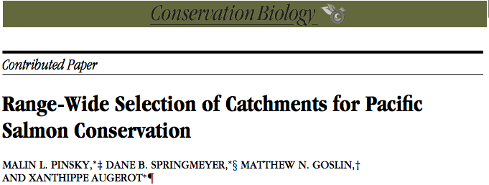
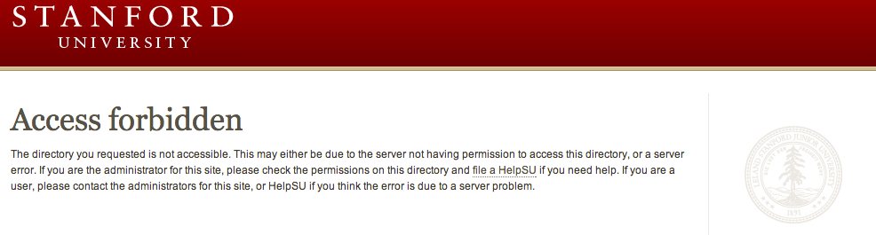
Notes:
This is a story of forbidden access....and Malin Pinsky, a former Stanford researcher who is now at Princeton. Once upon a time (in 2009) he published an article in Conservation Biology. In that article he made reference to some additional data sets that he made available online. The problem came when he left Stanford a couple of years later, and the data suddenly became inaccessible because where he had published it was in his AFS space. And everyone who tried to reach that data saw only this. He began a search for a way to make the data accessible again. And he discovered that the SDR can do that.

Slide 5
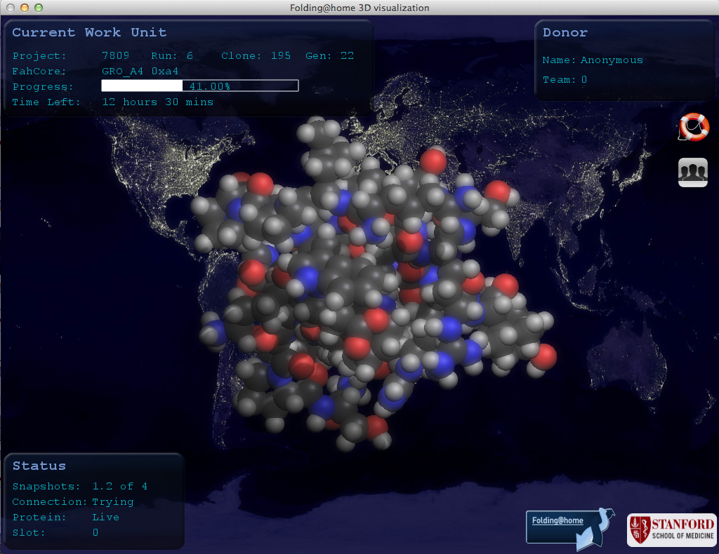
Notes:
Folding@home is a long-running project, well-known at Stanford and beyond. They have built software that allows anyone, anywhere in the world, to do protein folding calculations on the spare cycles on their computers. All that data is then compiled and analyzed here at Stanford. Over the years that this project has been running, you can imagine, they have compiled a huge amount of data that they are interested in making easily discoverable by researchers anywhere. The SDR can do that.

Slide 6
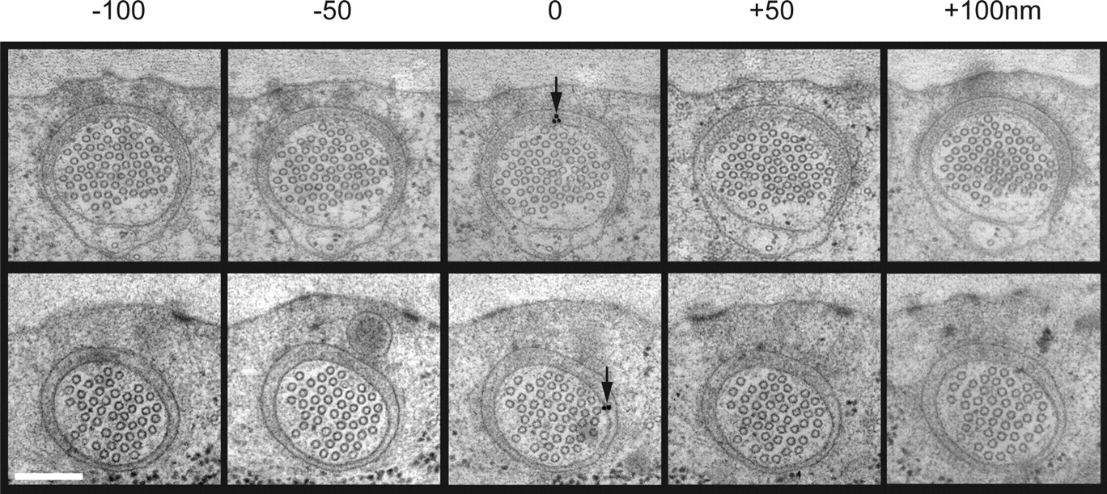
©2007 by Society for Neuroscience
Cueva J G et al. J. Neurosci. 2007;27:14089-14098
Notes:
Miriam Goodman and her research associate Juan Cueva use electron microscopy to study the neurobiology of the worm C. elegans. They have collected 1000s of images like these that are information-rich, storage-intensive, and hard for others to access. Miriam and Juan have published everything they are going to publish from these images, but they feel there is a lot more to learn from studying them, so they would like to share these data for others to use. The SDR can do that.

Slide 7
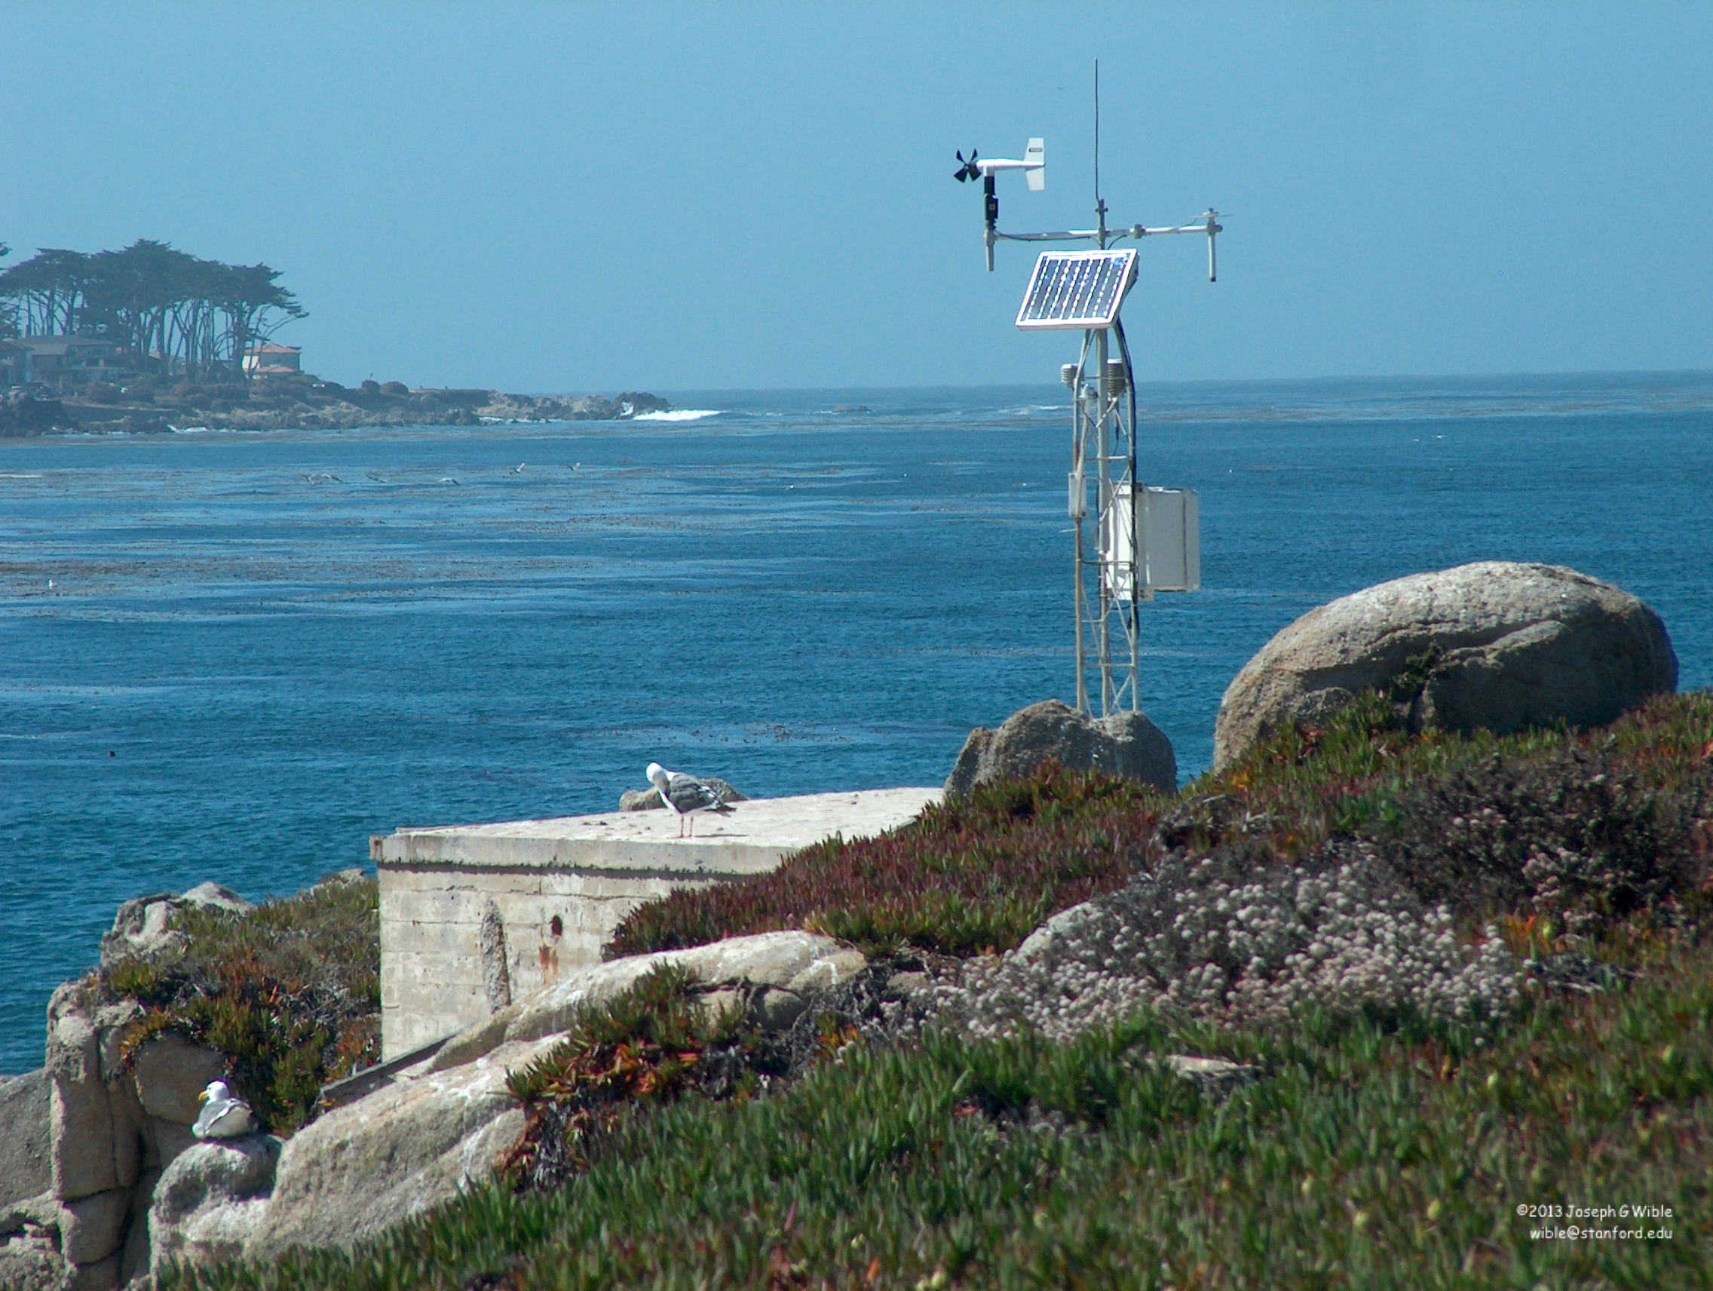
Notes:
Researchers at Hopkins Marine Station are involved in many long-term monitoring projects. Some of these projects have been going on for close to 100 years. This is a weather station where they measure things like wind, precipitation, and temperature every 10 minutes, every day of the year.

Slide 8
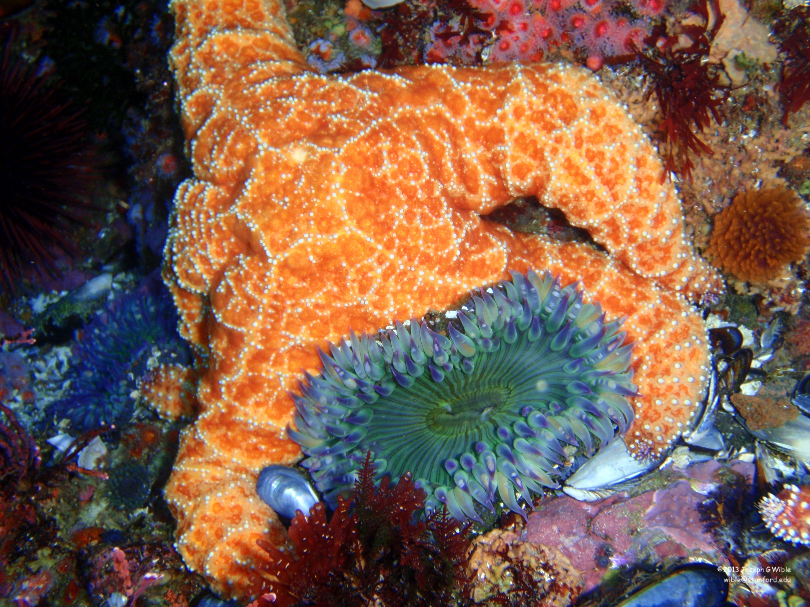
Notes:
They also monitor a variety of marine populations, like kelp, barnacles, and the sea stars shown here, as well as marine mammal populations like harbor seals, sea otters, and sea lions. Because these data provide insight into broad topics like climate change, and - because of their historical nature - they can't be replicated, it's important that they be preserved for use by other researchers in the future. And you probably know by now that....the SDR can do this too.
The question then is, How does the SDR do all of these things?

Slide 9
http://purl.stanford.edu/wp335yr5649
Notes:
This is the answer. The persistent URL, or PURL. When you deposit data into the SDR you get a persistent URL at which that data can always be accessed. Always.

Slide 10
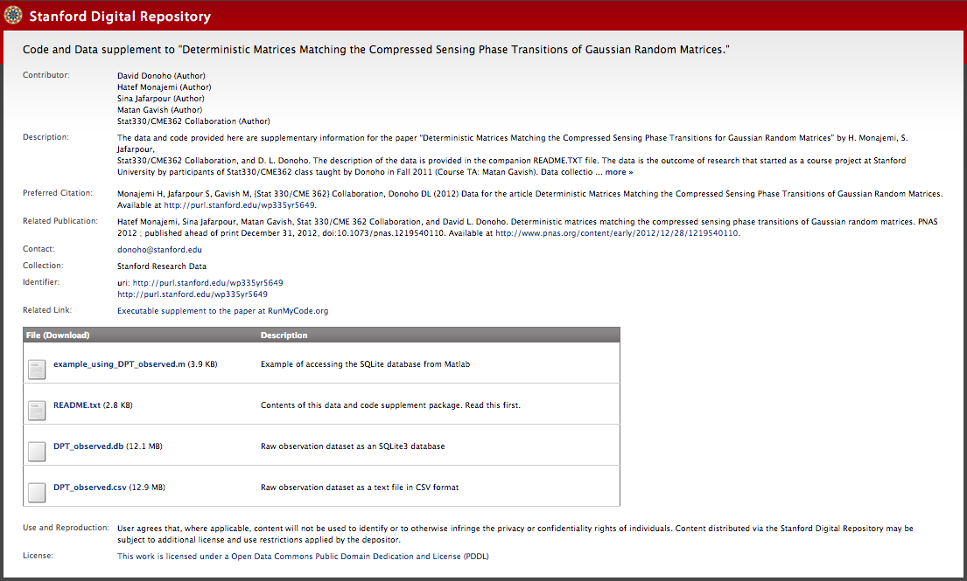
Notes:
Here's what a PURL landing page for a data deposit looks like. What you see here basically reflects the information that you are required to provide when you deposit data via our self-deposit web interface: authors or contributors to the work, a description of the data, how you would like these data to be cited, any associated publications, who to contact about the data, and any other related links. Then there is a list files that can be downloaded with descriptions. You also have options to choose an embargo period, assign a license, and decide whether you want the PURL landing page to be visible to anyone in the world or just Stanford.
We consider this a lightweight approach to meeting NSF requirements for data sharing and preservation.
And I'm hoping your next question is, How do I get a PURL for my data? It's very easy to do, takes just a few minutes, and three simple steps.

Slide 11
amyhodge@stanford.edu
Notes:
Step one. Email me. Access to the web-based self-deposit interface is via your SUNet ID – and to anyone with a SUNet ID (faculty, research staff, post-docs, students), however, it is currently gated, so I need to specifically give access to whomever is making or reviewing deposits. You also may need to talk with me about what kind of data you have and how you want to organize it, because it could make a difference with regard to whether you have access just to create PURLs or whether you can create an entire collection.

Slide 12
sdr.stanford.edu
Notes:
Step two. Go to sdr.stanford.edu. Here you can create a new item, get your persistent URL, upload your files, and describe the data. You will also need to agree to the terms of deposit. The SDR is content agnostic – you can deposit files in any format.

Slide 13

Notes:
Step three. Publish. Easy as that.

Slide 14
amyhodge@stanford.edu

